Slide 1

Coursera capstone
Battle of the Neighborhoods

Slide 2
Coursera capstone
Problem Statement
Dubai is a renowned city for the wealthy. It is a popular destination for travelers on business as well as leisure. The city with its central location and warm climate on top of its capital flow presents a great opportunity for restaurants and hotel businesses.
In this exercise, we will explore FourSquare API data to determine where a new hotel/restaurant business would succeed in Dubai. Our business will need to be based in close proximity to near high-rent areas that offer a demographic of individuals most likely to have disposable income to spend on eating out or travelling to venues geared towards commercially active areas.
The venue will also need to be in a neighborhood that is commercially active but not flooding with competition.
The exercise will explore venue data from FourSquare API and Dubai's average rent and proximity to the top high-rent areas, by neighborhood.

Slide 3
Coursera capstone
Data Overview
We will utilize two sets of data from different sources: The FourSquare API to explore most common venues clustered by neighborhoods, and a csv file named “Dubai_neighborhoods.csv” that contains average rent, latitude / longitude data, and distance from major airports by neighborhood.
Data used
FourSquare API
Dubai_neighborhood.csv

Slide 4
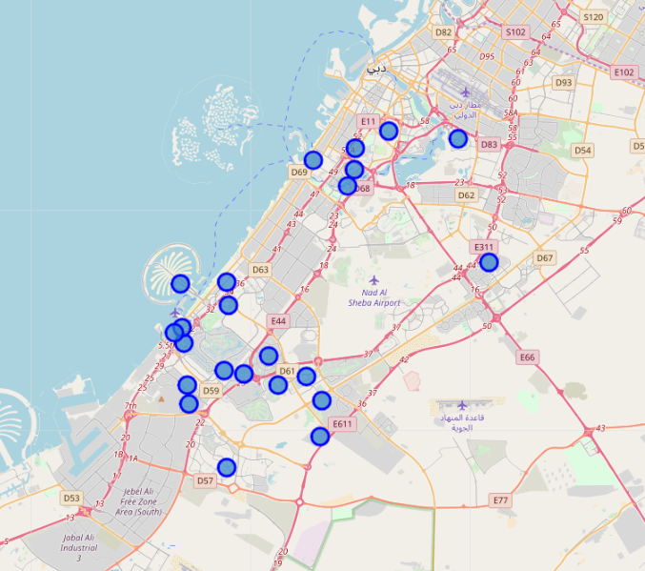
Coursera capstone
Data Overview – FourSquare API
Using the FourSquare API, we will gather data on most common venues to determine market share viability and competition in our areas of interest, to be discussed in the next section.
Zabeel
DIFC
Jumeirah
Palm Jumeirah

Slide 5
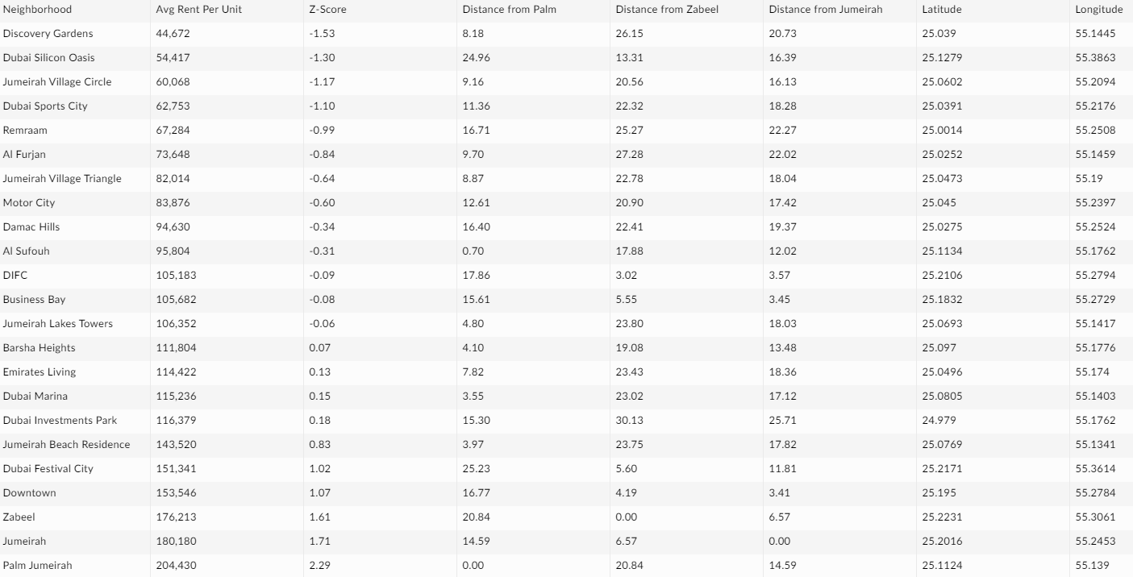
Coursera capstone
Data Overview – Dubai_neighborhood.csv
From the .csv file, we can determine that, using the z-score, the most reasonable rent areas and proximity to the top three high-rent areas are from Al Sufauh to Dubai Marina, which have z-scores closest to 0. We will explore these areas and determine best locations

Slide 6
Coursera capstone
EXPLORATORY ANALYSIS
After reviewing our preliminary findings, we can determine that Al Sufouh, DIFC, Business Bay, Jumeirah Lake Towers, and Barsha Heights best fit our targeted neighborhood, and we will focus on these neighborhoods.
To start, a master dataframe was created in Pandas for analysis and visualization. As our business will be a hotel / restaurant, I focused on the count of venues for ‘hotels’ and ‘restaurants’ in these neighborhoods.
We want to find a neighborhood that is commercially active but not flooding with competition. With the business being a hotel / restaurant, I focused on competitive market for hotels since that’s what our business will likely show up as a venue category.

Slide 7
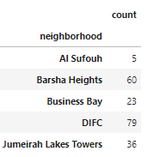
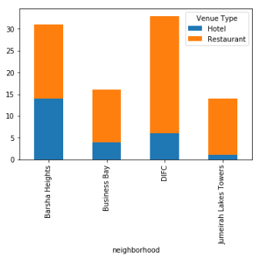
Coursera capstone
EXPLORATORY ANALYSIS
As the table on the left shows, DIFC and Barsha Heights seem to be the most commercially active and will be our two final candidates.
The right table shows competitive analysis of Hotels and Restaurants in the neighborhoods
It seems that DIFC has both the highest number of venues in our category yet has the lower hotel-to-restaurant ratio, making it both a commercially active area yet less competitive.

Slide 8
Coursera capstone
Conclusion
DIFC, also known as Dubai International Finance Center, will be our final candidate to open a hotel / restaurant business as it is:
Close to two of our 3 highest rent areas, attracting people with disposable income
Commercially active with 79 hotel and restaurants combined in the area
Less competitive in the hotel market

